Slide 1

CSCI 476: Computer Security
Lecture 4: Introduction to Security + Threat Modeling
Reese Pearsall
Fall 2022
*all images are stolen from the internet
https://www.cs.montana.edu/pearsall/classes/fall2022/476/main.html

Slide 2
Announcements
TA
Karishma Rahman
karishma.rahman.bd@gmail.com
Office Hours: Tuesdays 1:00 pm to 3:00 pm
Location: Barnard 259
Lab 1 Due Thursday 9/15 @ 11:59 PM
You have one late pass for the semester

Slide 3

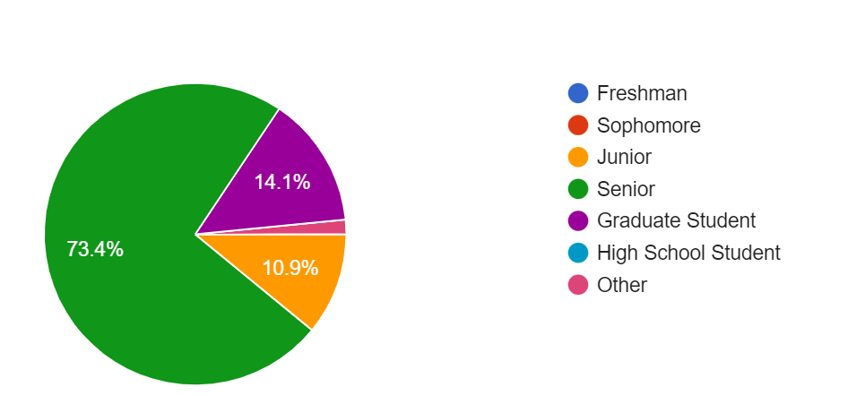
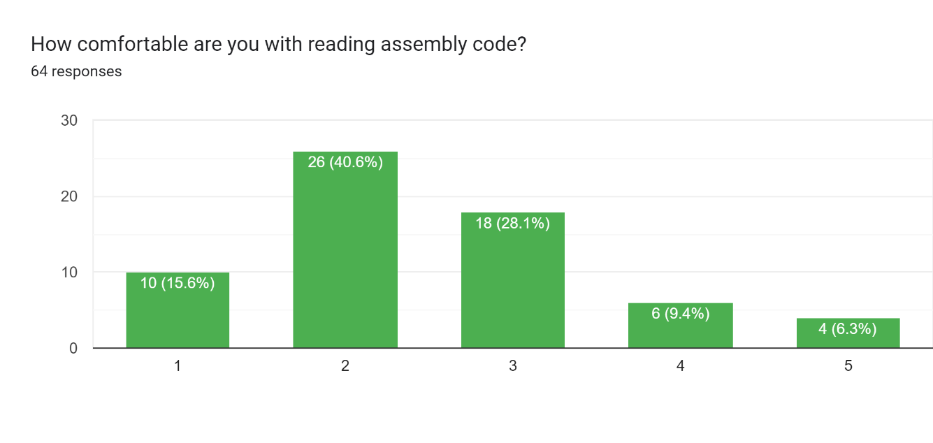
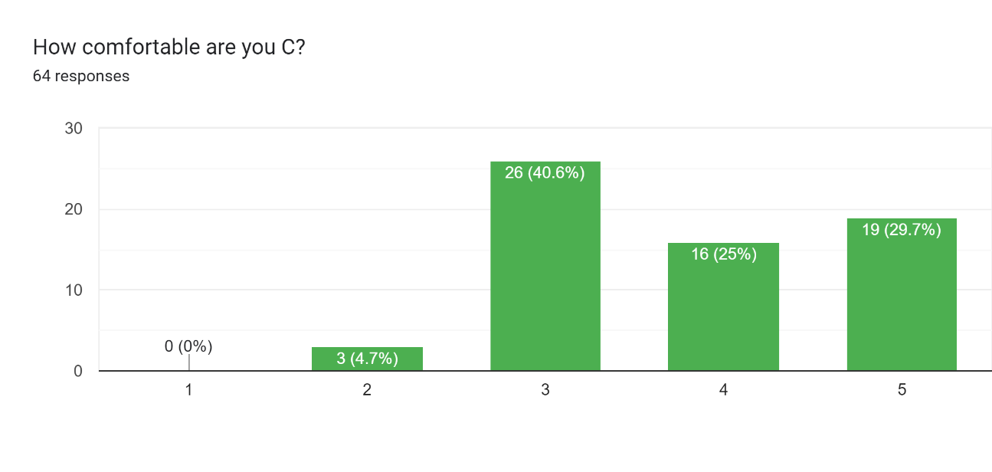
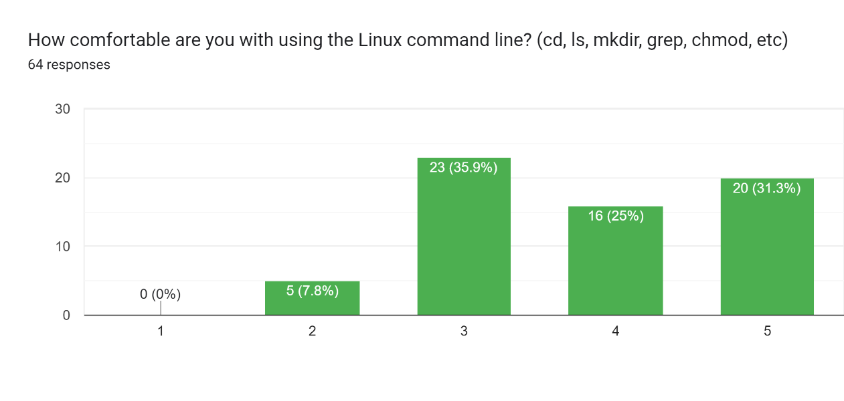
From the questionnaire…
I can't touch on every security topic, but I hope I can cover as many interesting areas as I can ☺

Slide 4
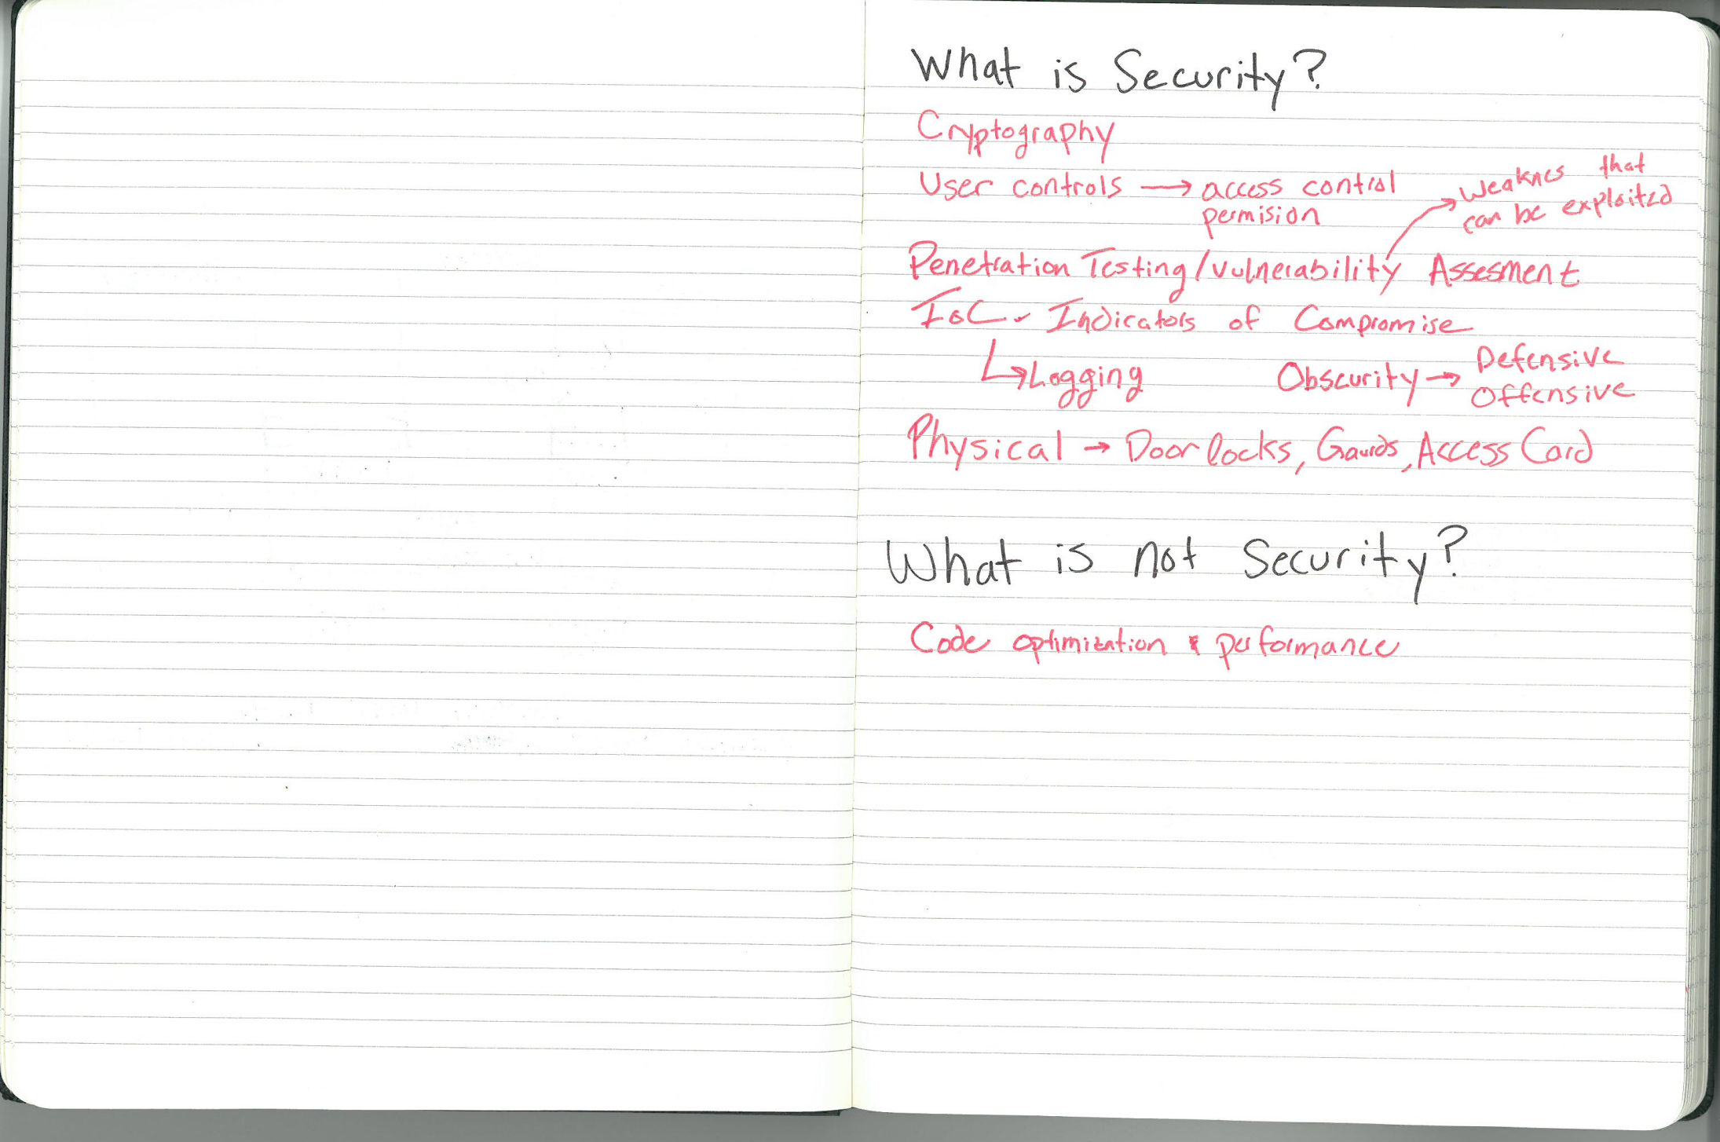
What is security? (What is security not?)

Slide 5
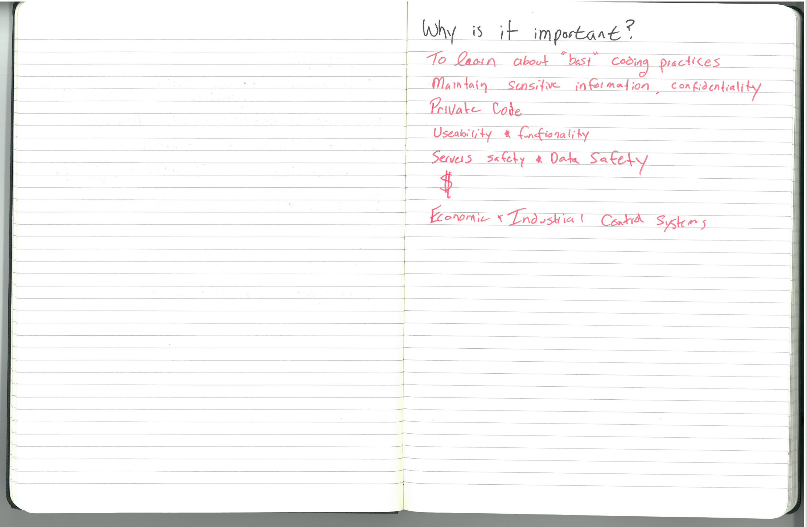
Why is it important?

Slide 6
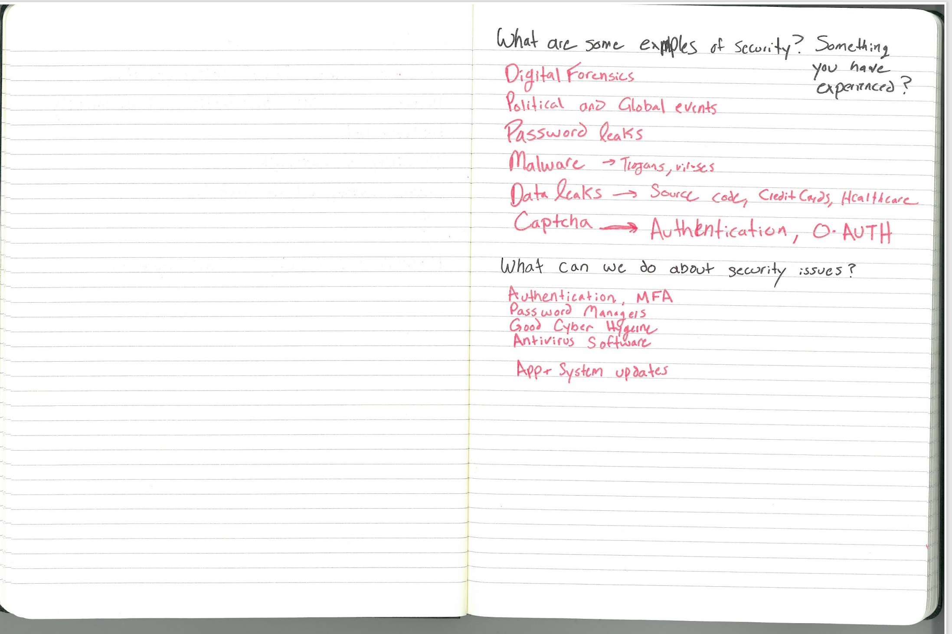
Popular examples? Examples you’ve encountered?

Slide 7
What can we do about security issues?

Slide 8
Security Basics
The CIA Triad is a widely accepted model for evaluating the security of a system. Consists of three important principles
CIA Triad

Slide 9

Security Basics
C
The CIA Triad is a widely accepted model for evaluating the security of a system. Consists of three important principles
confidentiality
Confidentiality- protection from unauthorized access
CIA Triad

Slide 10

Security Basics
C
The CIA Triad is a widely accepted model for evaluating the security of a system. Consists of three important principles
confidentiality
Confidentiality- protection from unauthorized access
Integrity- protection from unauthorized modifications
I
CIA Triad
integrity

Slide 11

Security Basics
C
The CIA Triad is a widely accepted model for evaluating the security of a system. Consists of three important principles
confidentiality
Confidentiality- protection from unauthorized access
Integrity- protection from unauthorized modifications
I
CIA Triad
A
Availability- protection from interruption
integrity
availability

Slide 12
Common Threats & Attack Vectors
Denial of Service (DoS / DDos)- attack with intent to shut down a machine or network
Violates the availability property

Slide 13
Common Threats & Attack Vectors
Denial of Service (DoS / DDos)- attack with intent to shut down a machine or network
Violates the availability property
Information Leakage / Data Corruption- unauthorized or accidental reveal of sensitive information
Violates the confidentiality property
Violates the integrity property

Slide 14
Common Threats & Attack Vectors
Denial of Service (DoS / DDos)- attack with intent to shut down a machine or network
Violates the availability property
Information Leakage / Data Corruption- unauthorized or accidental reveal of sensitive information
Violates the confidentiality property
Violates the integrity property
Privilege Escalation- gaining illicit permissions beyond what is intended for that user
Violates the confidentiality property
Violates the integrity property

Slide 15
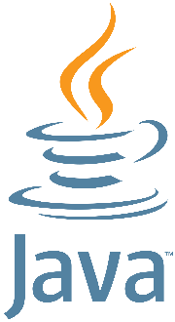

Defense Mechanisms
Formal verification
Software testing
Refactoring software and safe coding practices
Built-in mitigations

Slide 16
Threat Modeling
NEED: a consistent and structured approach for defense and assessing risk

Slide 17
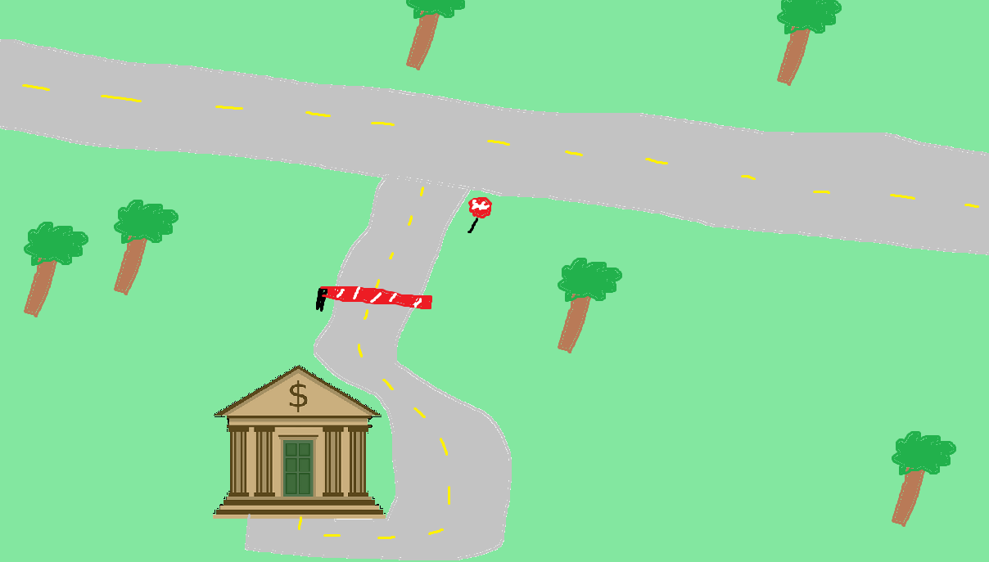


Assessing Risk
We expect users to interact with our system in a certain way

Slide 18
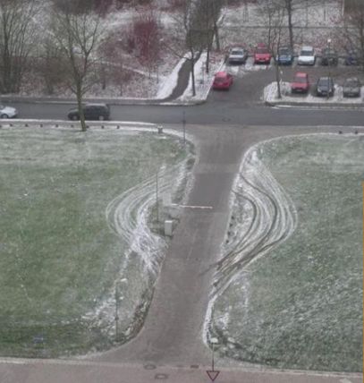

Assessing Risk
We expect users to interact with our system in a certain way
When someone interacts with our system in a way that we did not intend… it could have harmful consequences

Slide 19
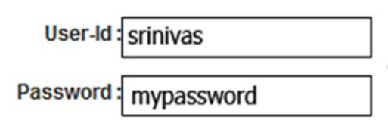
Assessing Risk
We expect users to interact with our system in a certain way
We might expect a user to input a valid username and password when they attempt to log in
When someone interacts with our system in a way that we did not intend… it could have harmful consequences

Slide 20
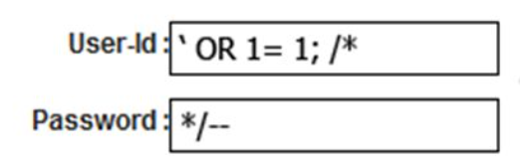
Assessing Risk
We expect users to interact with our system in a certain way
We might expect a user to input a valid username and password when they attempt to log in
When someone interacts with our system in a way that we did not intend… it could have harmful consequences
What if they did something…….. weird?

Slide 21
Assessing Risk
We expect users to interact with our system in a certain way
We might expect a user to input a valid username and password when they attempt to log in
When someone interacts with our system in a way that we did not intend… it could have harmful consequences
What if they did something…….. weird?
LOGIN SUCCESS

Slide 22
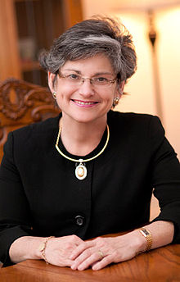

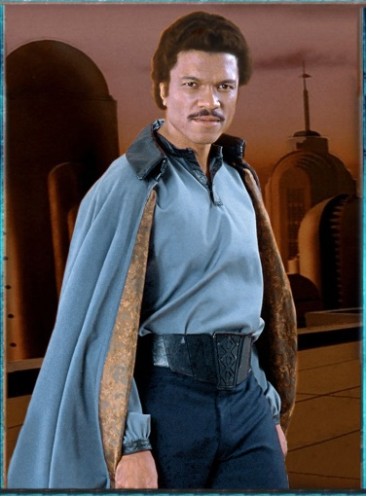

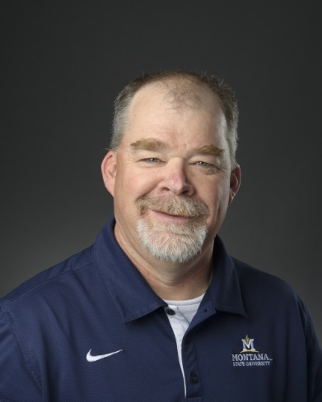
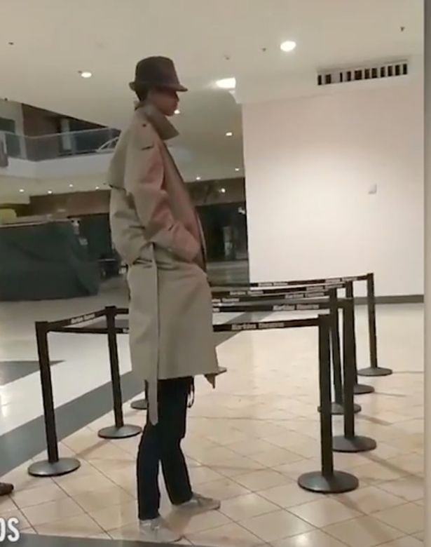
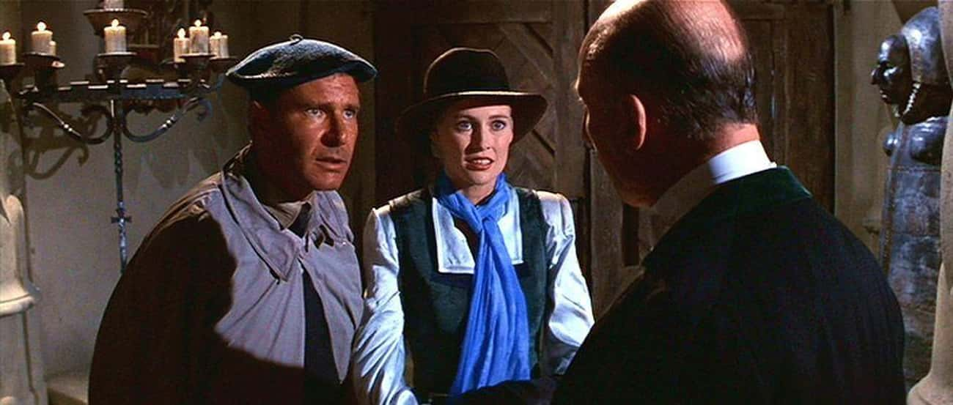

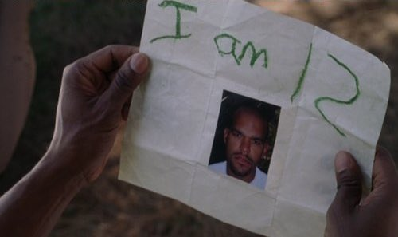

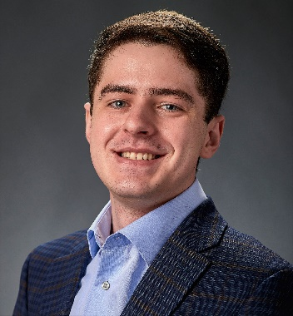
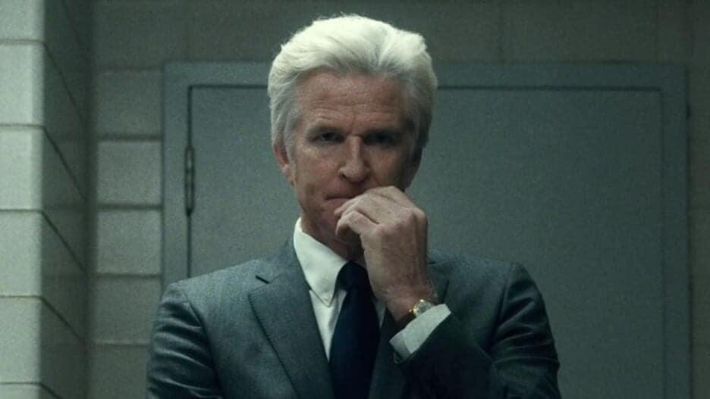
Who do we trust?
Are they honest? Are they reliable? Are they dependable? What are their intentions?

Slide 23
Who do we trust?
Trust as little as possible
Are they honest? Are they reliable? Are they dependable? What are their intentions?

Slide 24
Who do we trust?
Trust as little as possible
Distrust proportionally to level of risk
Are they honest? Are they reliable? Are they dependable? What are their intentions?

Slide 25
Who do we trust?
Trust as little as possible
Be aware of your technology
Distrust proportionally to level of risk
Are they honest? Are they reliable? Are they dependable? What are their intentions?

Slide 26
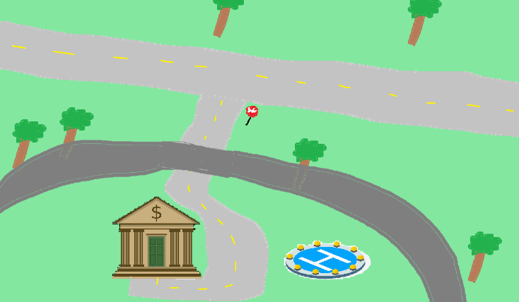
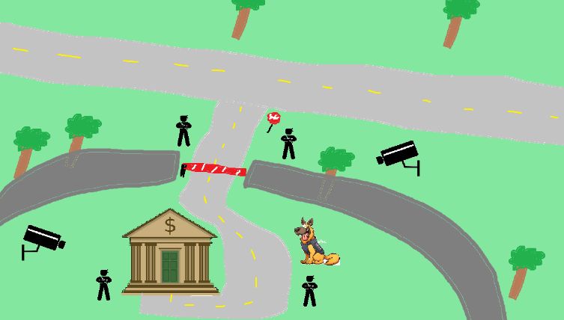
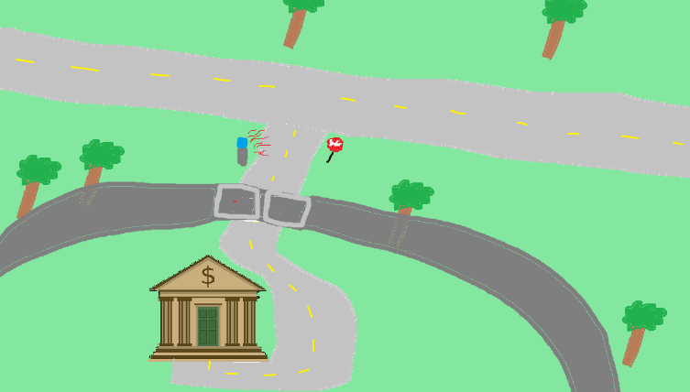
Perfect security is impossible

Slide 27
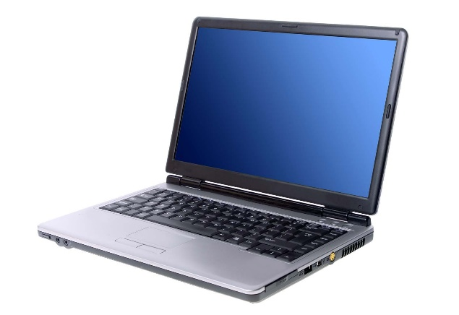
Perfect security is impossible
New assets

Slide 28
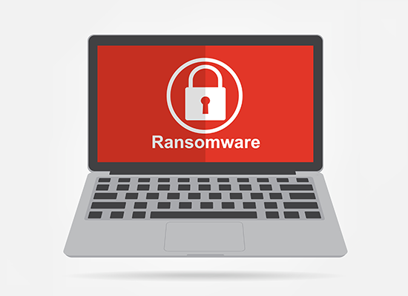
Perfect security is impossible
New assets
New threats

Slide 29
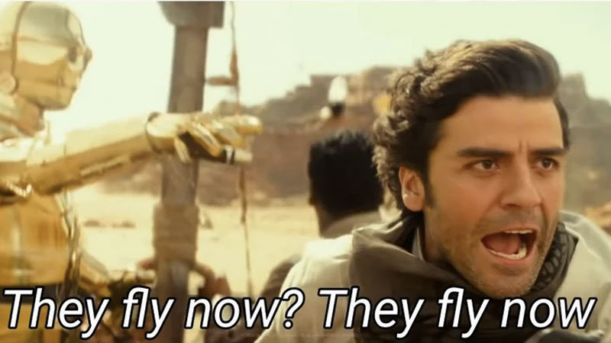
Perfect security is impossible
New assets
New threats
New capabilities

Slide 30
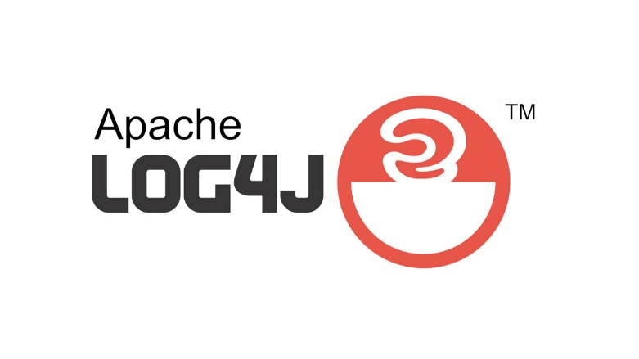
Perfect security is impossible
New assets
New threats
New capabilities
New technology

Slide 31
Perfect security is impossible
New assets
New threats
New capabilities
New technology
My goal is to teach you important cybersecurity principles that are universal across any system

Slide 32
Threat Modeling
You develop a threat model by focusing on four key questions
What are you building?
What are the assets?
What can go wrong?
What should you do about those things that can go wrong?
Did you do a decent job of analysis?

Slide 33
Threat Modeling
Brainstorming
Free-form brainstorming- gather around a whiteboard; enumerate threats/possible defenses
Scenario Analysis- Propose a scenario and ask “what might go wrong?”
Pre-Mortem- Assuming a failure or compromise, what do you do next?
Movie plotting – Pick outrageous ideas; what happens next?
Literature review- study systems that are similar to yours

Slide 34
Threat Modeling Practice
Free-form brainstorming- gather around a whiteboard; enumerate threats/possible defenses
Scenario Analysis- Propose a scenario and ask “what might go wrong?”
Pre-Mortem- Assuming a failure or compromise, what do you do next?
Movie plotting – Pick outrageous ideas; what happens next?
Literature review- study systems that are similar to yours
Let's develop a threat model
You are at a bar, and you hand your phone to a cute person …

Slide 35
Threat Modeling Practice
Free-form brainstorming- gather around a whiteboard; enumerate threats/possible defenses
Scenario Analysis- Propose a scenario and ask “what might go wrong?”
Pre-Mortem- Assuming a failure or compromise, what do you do next?
Movie plotting – Pick outrageous ideas; what happens next?
Literature review- study systems that are similar to yours
Let's develop a threat model
You are at a bar, and you hand your phone to a cute person …
What are your assets?
What can go wrong?
What things can be done to prevent those things?
If something bad happens, what can we do?

Slide 36
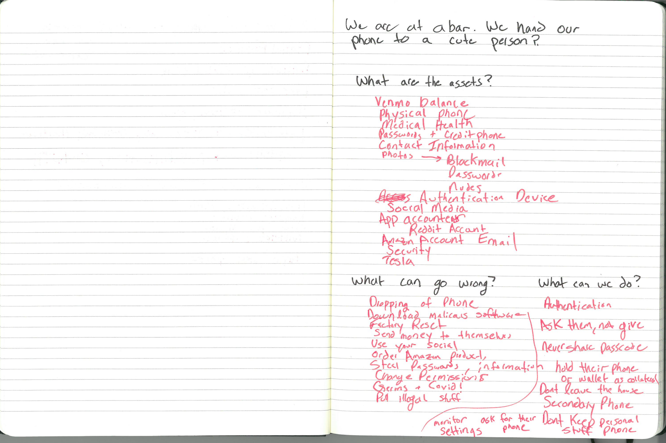
Threat Modeling Practice
Free-form brainstorming- gather around a whiteboard; enumerate threats/possible defenses
Scenario Analysis- Propose a scenario and ask “what might go wrong?”
Pre-Mortem- Assuming a failure or compromise, what do you do next?
Movie plotting – Pick outrageous ideas; what happens next?
Literature review- study systems that are similar to yours
Let's develop a threat model
You are at a bar, and you hand your phone to a cute person …
What are your assets?
What can go wrong?
What things can be done to prevent those things?
If something bad happens, what can we do?

Slide 37
Structured Approaches
WE NEED STRUCTURE
Asset-centric: focus on things of value: things attack want; things you want to protect
Attacker-centric: focus on attackers/archetypes/personas and their capabilities
Software-centric: focus of SW; most SW is backed by structured models (CFG, State diagrams, etc)
Methodologies
STRIDE
Spoofing, Tampering, Repudiation, Info Disclosure, Denial of Service, Elevation of Privilege
Attack Trees
Attack Lists & Libraries (ie. Common and Current vulnerabilities)
(https://docs.microsoft.com/en-us/azure/security/develop/threat-modeling-tool-threats)
There is no “right” choice

Slide 38
Structured Approaches
Asset-centric: focus on things of value: things attack want; things you want to protect
Attacker-centric: focus on attackers/archetypes/personas and their capabilities
Software-centric: focus of SW; most SW is backed by structured models (CFG, State diagrams, etc)
Methodologies
STRIDE
Spoofing, Tampering, Repudiation, Info Disclosure, Denial of Service, Elevation of Privilege
Attack Trees
Attack Lists & Libraries (ie. Common and Current vulnerabilities)
(https://docs.microsoft.com/en-us/azure/security/develop/threat-modeling-tool-threats)
There is no “right” choice

Slide 39
Attack Trees
Goal: Open bank safe

Slide 40
Attack Trees
Goal: Open bank safe
Pick Lock
Learn Combo
Cut Open Safe
Improperly install safe

Slide 41
Attack Trees
Goal: Open bank safe
Pick Lock
Learn Combo
Cut Open Safe
Improperly install safe
Find written combo
Get combo from target

Slide 42
Attack Trees
Goal: Open bank safe
Pick Lock
Learn Combo
Cut Open Safe
Improperly install safe
Find written combo
Get combo from target
Threaten
Blackmail
Eavesdrop
Bribe

Slide 43
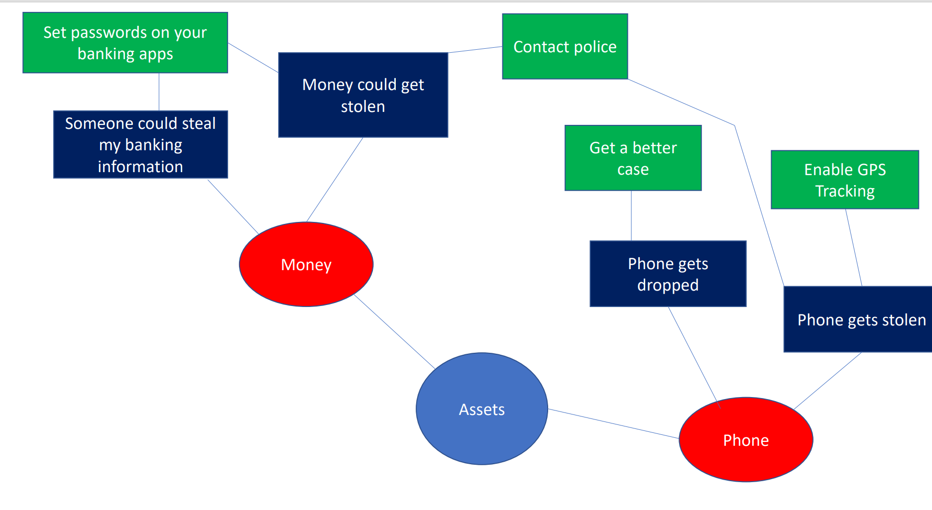
Mind Map

